Slide 1
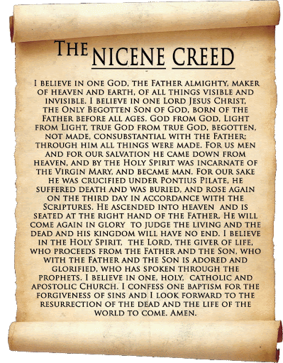
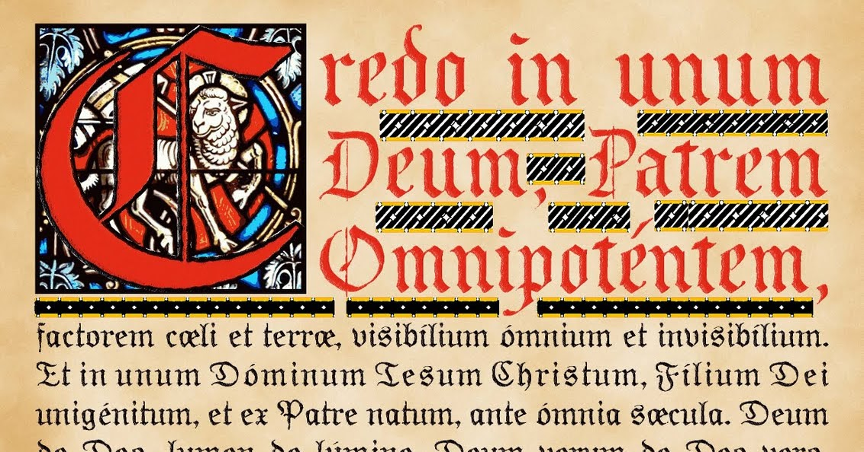
What We Believe in:
A Statement of Faith

Slide 2
Why creeds?
To summarize and define what we believe – A Statement of Faith
To avoid heresy, misunderstanding and false teaching
To affirm and unify us in the faith, to be of one mind and heart
To distinguish and set us apart from other religions, cults and sects
“Then you will know the truth and the truth will set you free”
John 8:32

Slide 3
We Believe in:
The one true God who lives eternally in three persons - the Father, the Son and the Holy Spirit
Hear, O Israel: The LORD our God, the LORD is one.
Deuteronomy 6:4
“I [Jesus] and the Father are one.“John 10:30
For through him [Christ] we both have access to the Father by one Spirit. Ephesians 3:18
Make disciples of all nations……. and baptising them in the name of the Father, Son and Holy Spirit. Matthew 29:20

Slide 4
We Believe in:
2. The love, grace and sovereignty of God in creating, sustaining, ruling, redeeming and judging the world.
In the beginning God created the heavens and the earth.
Genesis 1:1
For God did not send his Son into the world to condemn the world, but to save the world through him. John 3:17
By Him [Christ] all things were created….. And in Him all things hold together Colossians 1:16-17
But they will have to give account to him who is ready to judge the living and the dead. 1Peter 4;5

Slide 5
We Believe in:
3. The divine inspiration and supreme authority of the Old and New Testament Scriptures, which are the written Word of God - fully trustworthy for faith and conduct.
All Scripture is God-breathed and is useful for teaching, rebuking, correcting and training in righteousness, 2 Timothy 3:16
Above all, you must understand that no prophecy of Scripture came about by the prophet’s own interpretation. For prophecy never had its origin in the will of man, but men spoke from God as they were carried along by the Holy Spirit. 2 Peter 1:20-21

Slide 6
We Believe in:
4. The dignity of all people, made male and female in God's image to love, be holy and care for creation, yet corrupted by sin, which incurs divine wrath and judgement.
So God created man in his own image, in the image of God he created him; male and female he created them. Genesis 1:27
for all have sinned and fallen short of the glory of God, Romans 3:23
There is neither Jew nor Greek, slave nor free, male nor female, for you are all one in Christ Jesus. Galatians 3:28

Slide 7
We Believe in:
5. The incarnation of God’s eternal Son, the Lord Jesus Christ - born of the virgin Mary; truly divine and truly human, yet without sin.
The virgin will be with child and will give birth to a son, and they will call him Immanuel—which means, "God with us.“ Matthew 1:23
The Word became flesh and made his dwelling among us. We have seen his glory, the glory of the One and Only, who came from the Father, full of grace and truth. John 1:14
For in Christ all the fullness of the Deity lives in bodily form,
Colossians 2:9

Slide 8
We Believe in:
6. The atoning sacrifice of Christ on the cross: dying in our place, paying the price of sin and defeating evil, so reconciling us with God
For God was pleased to have all his fullness dwell in him [Christ], and through him to reconcile to himself all things, whether things on earth or things in heaven, by making peace through his blood, shed on the cross. Colossians 1:19-20
But he was pierced for our transgressions, he was crushed for our iniquities; the punishment that brought us peace was upon him, Isaiah 53:5

Slide 9
We Believe in:
7. The bodily resurrection of Christ, the first fruits of our resurrection; his ascension to the Father, and his reign and mediation as the only Saviour of the world.
For what I received I passed on to you as of first importance: that Christ died for our sins according to the Scriptures, that he was buried, that he was raised on the third day according to the Scriptures, 1 Corinthians 15:3
Praise be to the God and Father of our Lord Jesus Christ! In his great mercy he has given us new birth into a living hope through the resurrection of Jesus Christ from the dead, 1Peter 1:3

Slide 10
We Believe in:
8. The justification of sinners solely by the grace of God through faith in Christ.
For it is by grace you have been saved, through faith—and this not from yourselves, it is the gift of God— Ephesians 2:8
That if you confess with your mouth, "Jesus is Lord," and believe in your heart that God raised him from the dead, you will be saved. For it is with your heart that you believe and are justified, and it is with your mouth that you confess and are saved. Romans 10:9-10
Salvation is found in no other name Acts 4:12

Slide 11
We Believe in:
9. The ministry of God the Holy Spirit, who leads us to repentance, unites us with Christ through new birth, empowers our discipleship and enables our witness.
When he comes, he [the Holy Spirit] will convict the world of guilt in regard to sin and righteousness and judgment: John 16:8
You, however, are controlled not by the sinful nature but by the Spirit, if the Spirit of God lives in you. Romans 8:9
There are different kinds of gifts, but the same Spirit. 1 Corinthians12:3
no-one can say, "Jesus is Lord," except by the Holy Spirit. 1 Corinthians 12:3b

Slide 12
We Believe in:
10. The Church, the body of Christ both local and universal, the priesthood of all believers - given life by the Spirit and endowed with the Spirit's gifts to worship God and proclaim the gospel, promoting justice and love.
you are a chosen people, a royal priesthood, a holy nation, a people belonging to God, that you may declare the praises of him who called you out of darkness into his wonderful light. 1 Peter 2:9
His intent was that now, through the church, the manifold wisdom of God should be made known to the rulers and authorities in the heavenly realms, Ephesians 3;10
There are different kinds of gifts, but the same Spirit. 1 Corinthians12:3

Slide 13
We Believe in:
11. The personal and visible return of Jesus Christ to fulfil the purposes of God, who will raise all people to judgement, bring eternal life to the redeemed and eternal condemnation to the lost, and establish a new heaven and new earth.
For the Lord himself will come down from heaven, with a loud command, with the voice of the archangel and with the trumpet call of God, and the dead in Christ will rise first. 1 Thessalonians 4:16
For we will all stand before God’s judgment seat. Romans 14:10
But in keeping with his promise we are looking forward to a new heaven and a new earth, the home of righteousness. 2 Peter 3:13

Slide 14
Do you believe?:
Jesus said to her, "I am the resurrection and the life. He who believes in me will live, even though he dies; and whoever lives and believes in me will never die.
Do you believe this?“ John 11:25-26

